Slide 1
Definitions
segment
path record
path record
Road
One entire road might have several path records (ex: red and blue lines in the above picture).
One path record contains several points, representing the path.
One segment is defined by connecting two consecutive points of the same path.

Slide 2
Two ways to find the intersections
Since the shapefile doesn’t directly provide the intersection information. I used the following methods to find the intersections.
Find the duplicate points:
If there is a point on both paths where two paths intersect, then we can find the intersection. However, when tow paths on the same roads, there might also be the same point on the two paths.
This method found 6,208 intersection points.
See duplicate_points.html for the map view.
Use segments to find the intersection points:
Firts extract all the segments from all the path records.
Examine each segment with all the other segments nearby (see next page for the detail).
This method might also find the connecting point of two paths on the same road. But if two paths are on the straight road, the connecting point will not be a intersection.
This method found 15,900 intersection points.
See segmen_intersect.html for the map view. (I suggest use Safari to open the file.)

Slide 3
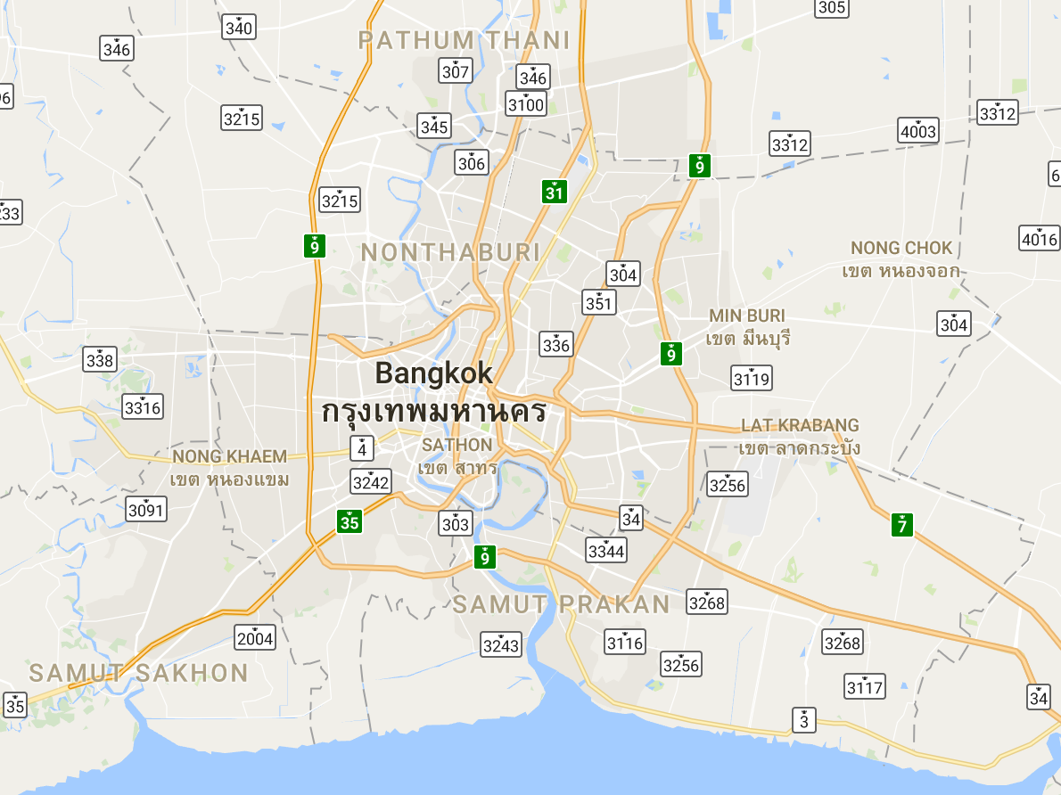
Nearby segments
To make the examination process run faster, I used following method.
First divide the map into several grids. There are more than 1,000,000 grids when the program was finding the intersections.
For each segment, I register the segment to the grids that the segment expands (the light blue grids for the blue line).
When finding the nearby segments, take the orange line for example, since its grids contains the grids for the blue line, then the program will check if there is an intersection of the two lines.

